Slide 1
Vibration Sensors

Slide 2
Vibration Sensors
For optimum performance of the machines, it is necessary to continuously monitor the vibration.
Monitoring changes in Vibration could solve any downtime and/or machine damage which results in financial loss.
Vibration can be defined as
The mechanical oscillation about an equilibrium position of a machine or component
The back and forth motion of a machine or component.

Slide 3
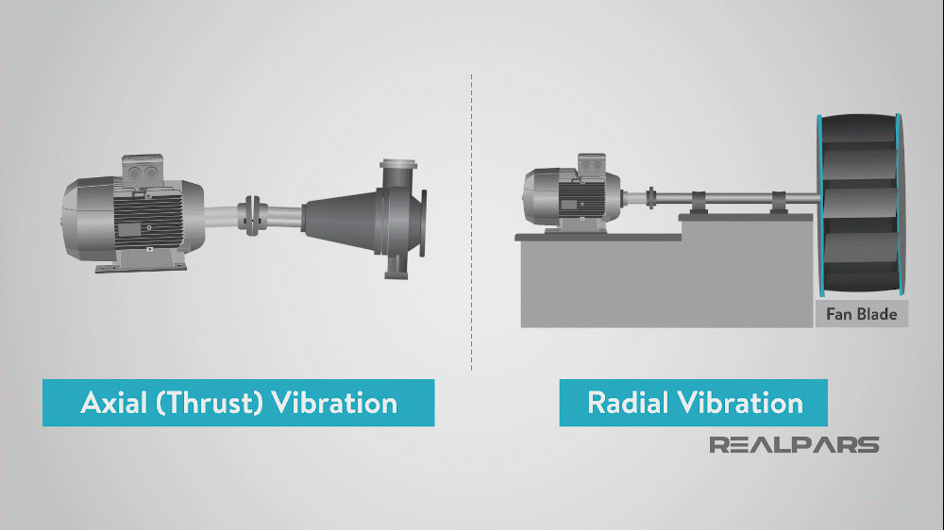
Vibration Sensors
In machine monitoring we are dealing with two types of vibration;
Axial (Thrust) Vibration
Radial Vibration

Slide 4
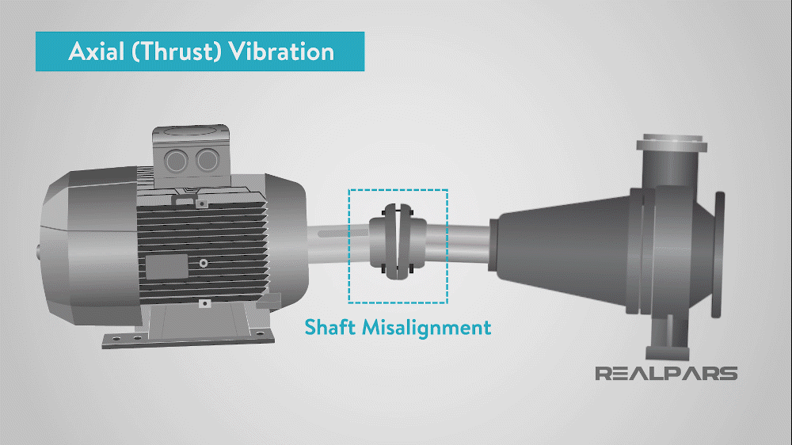
Axial (Thrust) Vibration

Slide 5
Axial (Thrust) Vibration

Slide 6
Types of Vibration Sensor
Accelerometer
Accelerometers are devices that measure the vibration, or acceleration of motion of a structure.
They have a transducer that converts mechanical force caused by vibration or a change in motion, into an electrical current using the piezoelectric effect.
There are two types of piezoelectric accelerometers,
High Impedance
Low Impedance

Slide 7
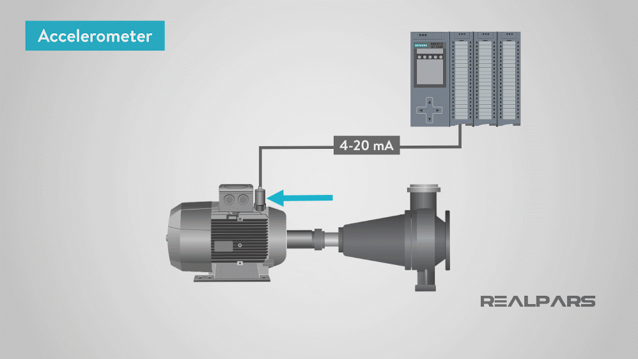
Accelerometer as Vibration Sensor

Slide 8
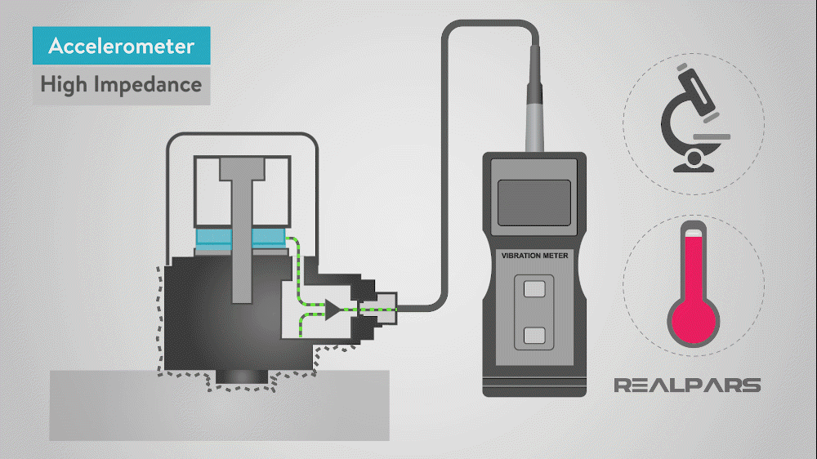
High Impedance Accelerometer
High impedance accelerometers produce an electrical charge which is connected directly to the measurement instruments.
They require special accommodations and instrumentation so they are found in research facilities or high-temperature applications.

Slide 9
Low Impedance Accelerometer
Low impedance accelerometers have a charge accelerometer as its front end as well as a built-in micro-circuit and transistor that converts that charge into a low impedance voltage.
This type of accelerometer easily interfaces with standard instrumentation which makes it commonly used in the industry.

Slide 10
Types of Vibration Sensor
Strain Gauge
Strain gauge measures the strain on a machine component.
A strain gauge is a sensor whose resistance varies with applied force; It converts force, pressure, tension, weight, etc., into a change in electrical resistance which can then be measured.
When external forces are applied to a stationary object, stress and strain are the results.
When there is a strain applied to any metallic wire, the length of that wire increases and the diameter decrease.
This increase in length and decrease in diameter will change the resistance of the wire which will give us our measurement of strain on our machine component.

Slide 11
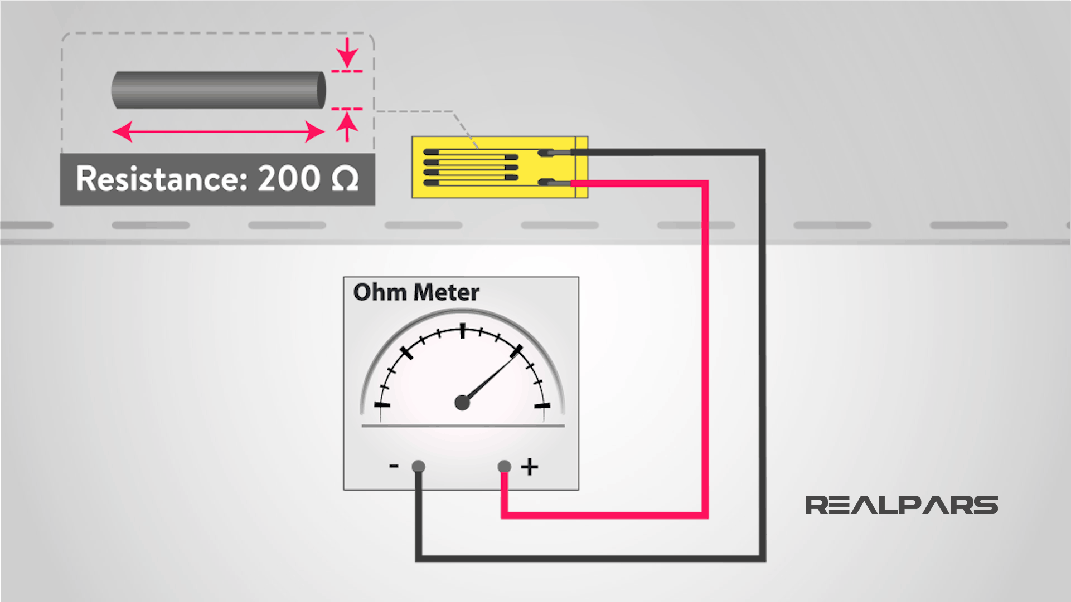
Strain Gauge as Vibration Sensor

Slide 12
Types of Vibration Sensor
Eddy-Current
Eddy-Current sensors are non-contact devices that measure the position and/or change of position of a conductive component.
When external forces are applied to a stationary object, stress and strain are the results.
These sensors operate with magnetic fields. The sensor has a probe which creates an alternating current at the tip of the probe.
The alternating current creates small currents in the component we are monitoring called eddy currents.
The sensor monitors the interaction of these two magnetic fields.

Slide 13
Types of Vibration Sensor
Eddy-Current
As the field interaction changes the sensor will produce a voltage proportional to the change in the interaction of the two fields.
When using Eddy-Current sensors it is important for the component to be at least three times larger than the sensor diameter for normal operation; otherwise, advanced calibration would be required.

Slide 14
Eddy current type of Vibration Sensor

Slide 15
How to Choose a Vibration Sensor
When choosing a vibration sensor for your application it is important to look at factors such as
Range and accuracy
– Environment conditions
– The shape of the measuring surface
Accelerometer is the most common because it has a good range of frequency, meaning it can sense slow and fast applications.
Along with the frequency, accelerometers are priced affordably and are durable.
They do have to be mounted directly to the machine which is common for vibration sensors.

Slide 16
How to Choose a Vibration Sensor
Eddy current or capacitive sensors have medium accuracy and are not optimal for high-resolution applications. They are very durable making them a good option for dirty environments.
Just like the accelerometers, they have to be directly mounted to the machine being monitored.
Lastly, strain gauges are both versatile and accurate while still suitable for hazardous environments.
They can be hard to install correctly and to get proper data your application will need amplifiers which can drive up the price.
For Choosing a Vibration Sensor
The range and accuracy
Environment conditions
The shape of the measuring surface

